Slide 1
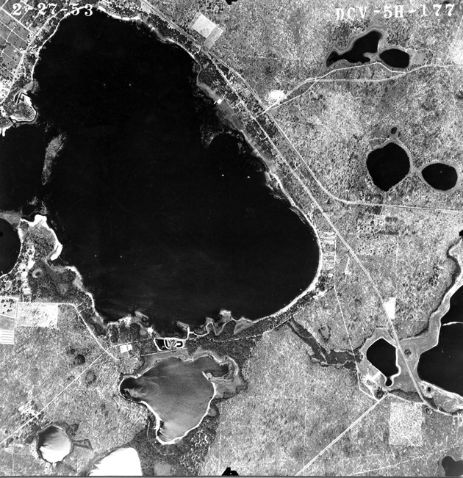
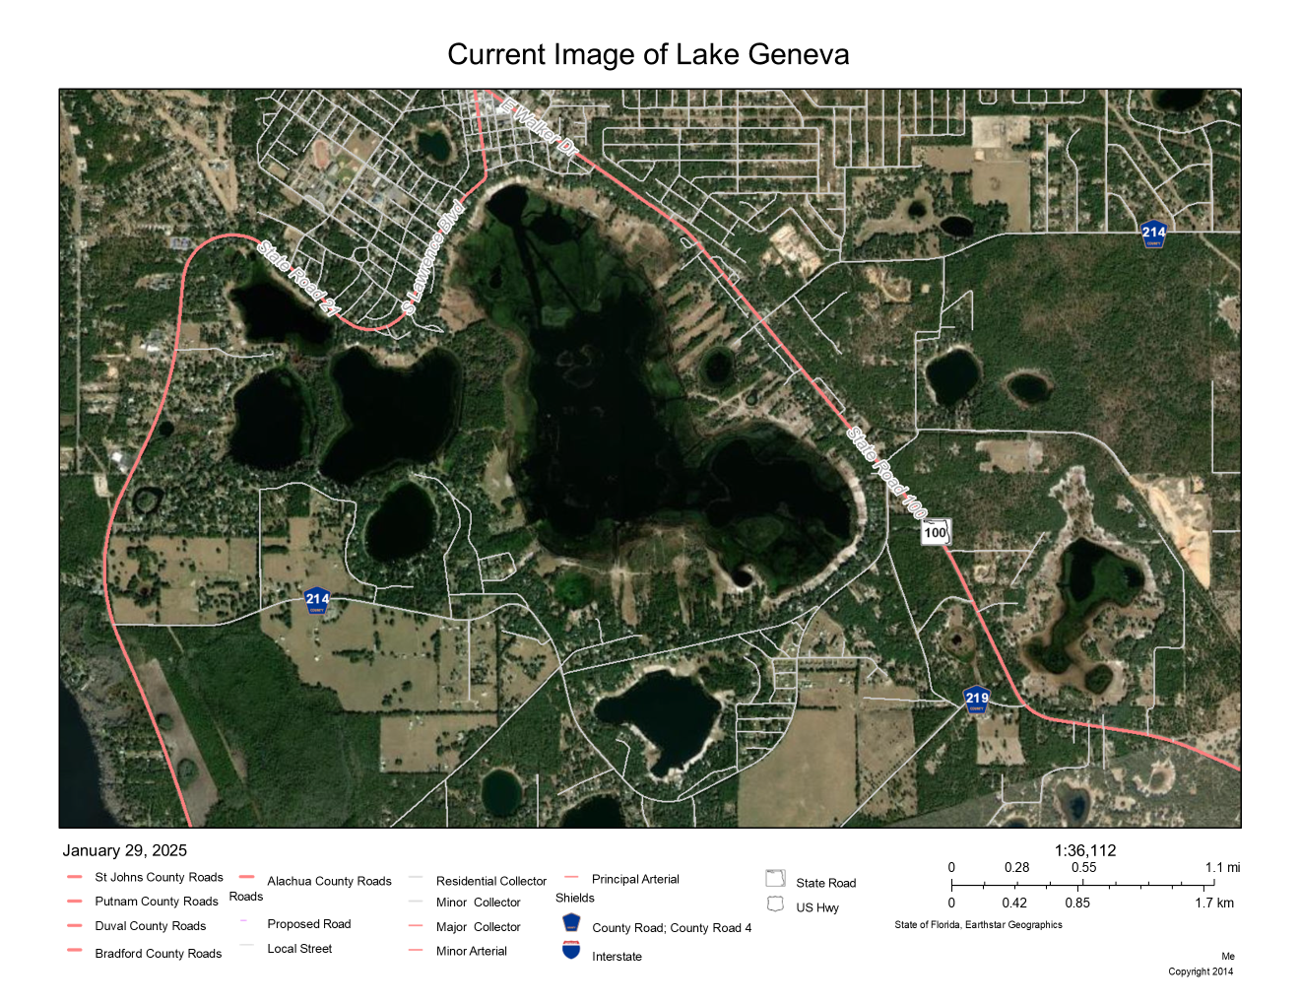
Lake Geneva Environmental Restoration Project
(Landowner Meeting)
30 January, 2025
SOLO
Clay County
City of Keystone Heights
Adams and Reese
Photo from 1953
Recent Photo

Slide 2
Agenda
Welcome and opening comments (SOLO)
Introduction of Key Leaders (COKH)
Ground Rules (COKH)
How surface water flows in the Keystone Heights area(COKH)
History (COKH)
  Lake Levels
  Black Creek Water Resource Development Project
Environmental Resource Permit (A&R)
Lake Geneva Environmental Restoration Project (COKH)
Way Forward
Question and Answer (All Organizations)

Slide 3
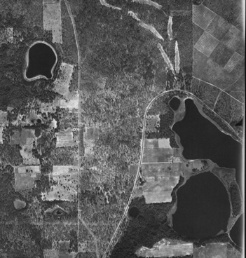
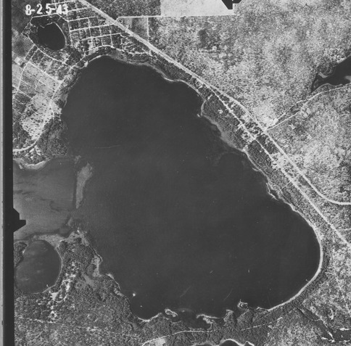
Introductions
West Lake Geneva -1939
East Lake Geneva -1943

Slide 4
Ground Rules
Let’s have a productive meeting:
Hold your questions to the end of the presentation
  We expect to answer most questions during the presentation
Please minimize sidebar discussions so everyone can hear the presentation
  If you must have a conversation, please whisper, or take the conversation out into the hallways
During Q&A, please do not speak over folks asking questions or the person answering the questions.
  Please limit any comments or questions to 2-3 minutes so we can answer and then get to as many other questions as possible
  If you have concerns with the answer, ask one follow up question and then follow up with the responder after the meeting
  If we do not have an answer for your question, we will note it and seek an answer for you
Please check our contact roster in the back to see if we have your correct address, phone number, and email address
We are all guests of Trinity Baptist Church tonight and in God’s house

Slide 5
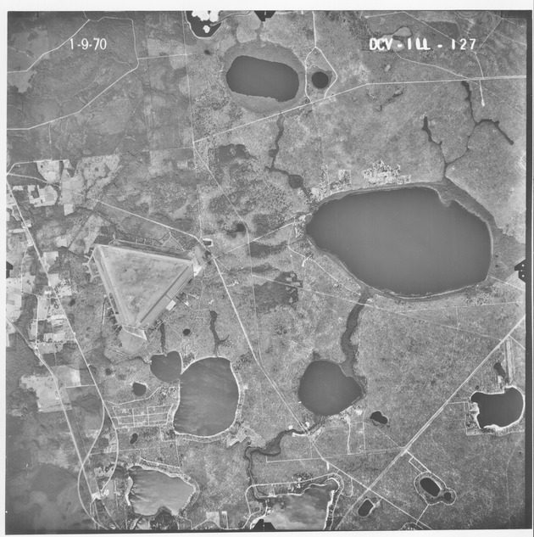
How Surface Water Flows in the Keystone Heights Area
Blue Pond
Blue Pond
Alligator Creek
Lowery Lake
Alligator Creek
Magnolia Lake
Alligator Creek
Lake Brooklyn
Starke
Lowery Lake
Magnolia Lake
Middleburg
= Direction of Surface Flow
Brooklyn Lake

Slide 6
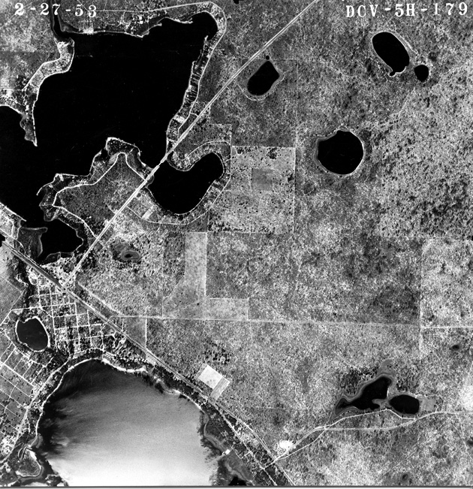
How Surface Water Flows in the Keystone Heights Area
Middleburg
Lake Brooklyn
Lake Brooklyn
Alligator Creek/ Ginger Creek
Lake Keystone
Alligator Creek
Lake Geneva
Keystone Lake
Lake Geneva
Palatka
= Direction of Surface Flow

Slide 7
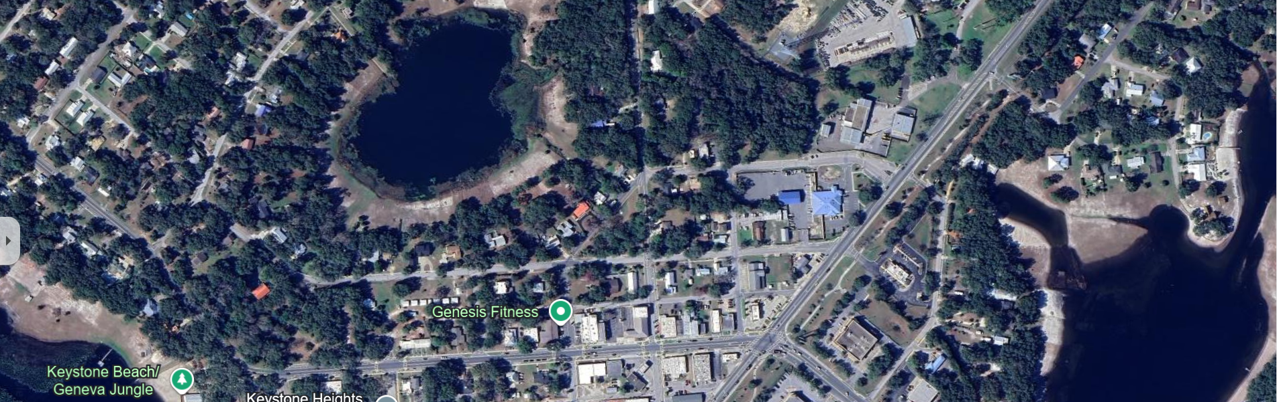
Nightingale
Clay Electric
SR100
Hebron
N
R2T
Brooklyn
Magnolia
SR21
Geneva
113.7’
112.3’
111.5’
112’
111.6’
27JAN25
107.2’
104.7’
106.7’
94.5’
06NOV24, Survey
Invert Elevation(NAVD) Source Data: CDM Smith Memo, Dated March 16,2022

Slide 8
How Surface Water Flows in the Keystone Heights Area
Keystone Heights
Lake Geneva
Alligator Creek
Oldfield Pond
Lake Geneva
Palatka
Oldfield Pond
= Direction of Surface Flow

Slide 9
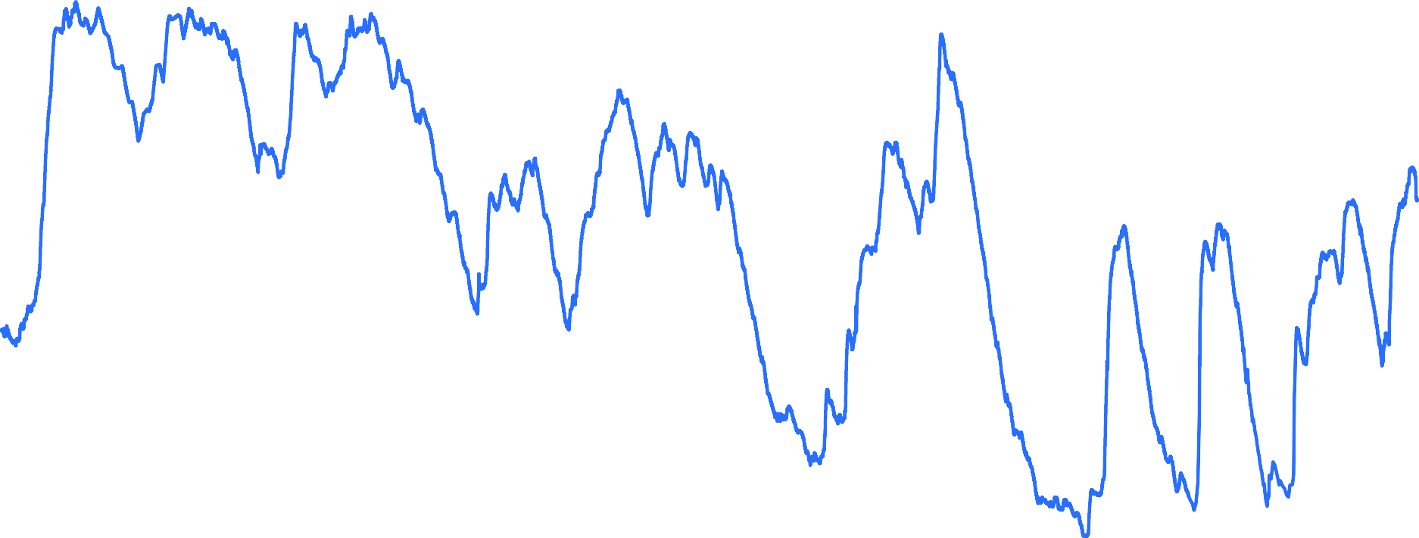
Recorded Lake Brooklyn Stages
120
115
110
105
100
95
90
85
80
Recorded Lake Stage, ft (NAVD 88)
113.7’
= Flow to Geneva
10/3/1954
6/11/1968
2/18/1982
10/28/1995
7/6/2009
3/15/2023

Slide 10
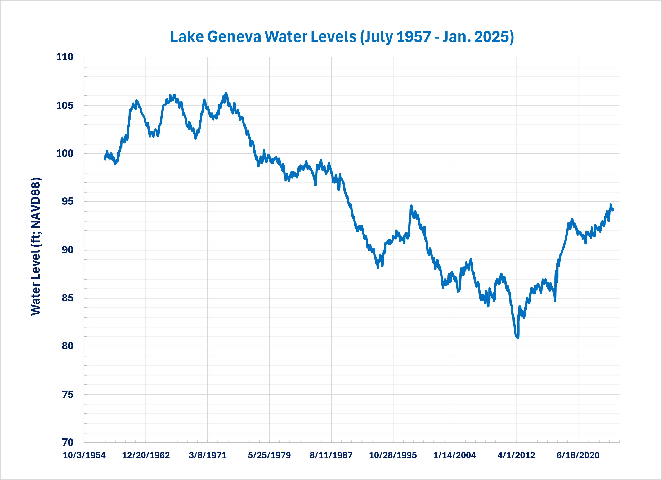
Lake Geneva Stages
Flow to Oldfield Pond =
104.4 ft
102.9 ft

Slide 11
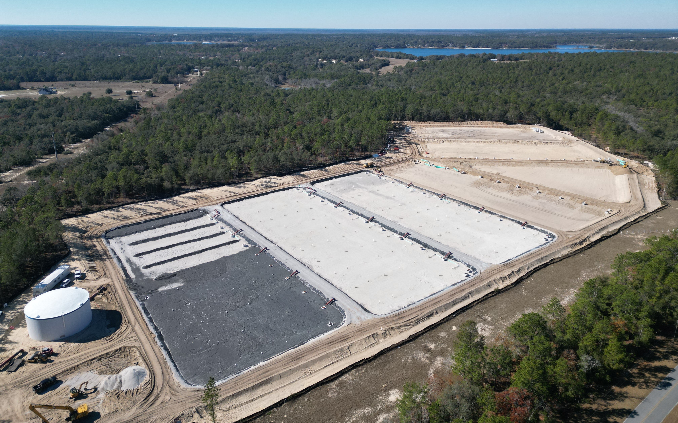
Black Creek Water Resource Development Project

Slide 12
NEED FOR PROJECT
Water Supply
Fresh groundwater alone cannot supply water needs for the northeast Florida region
Alternative water supplies, such as the Black Creek WRD project, are key components necessary to meet the region’s future water needs
Minimum Flows and Levels
Recharge for the Minimum Flows and Minimum Levels (MFLs) in the Keystone Heights region and the Lower Santa Fe Basin

Slide 13
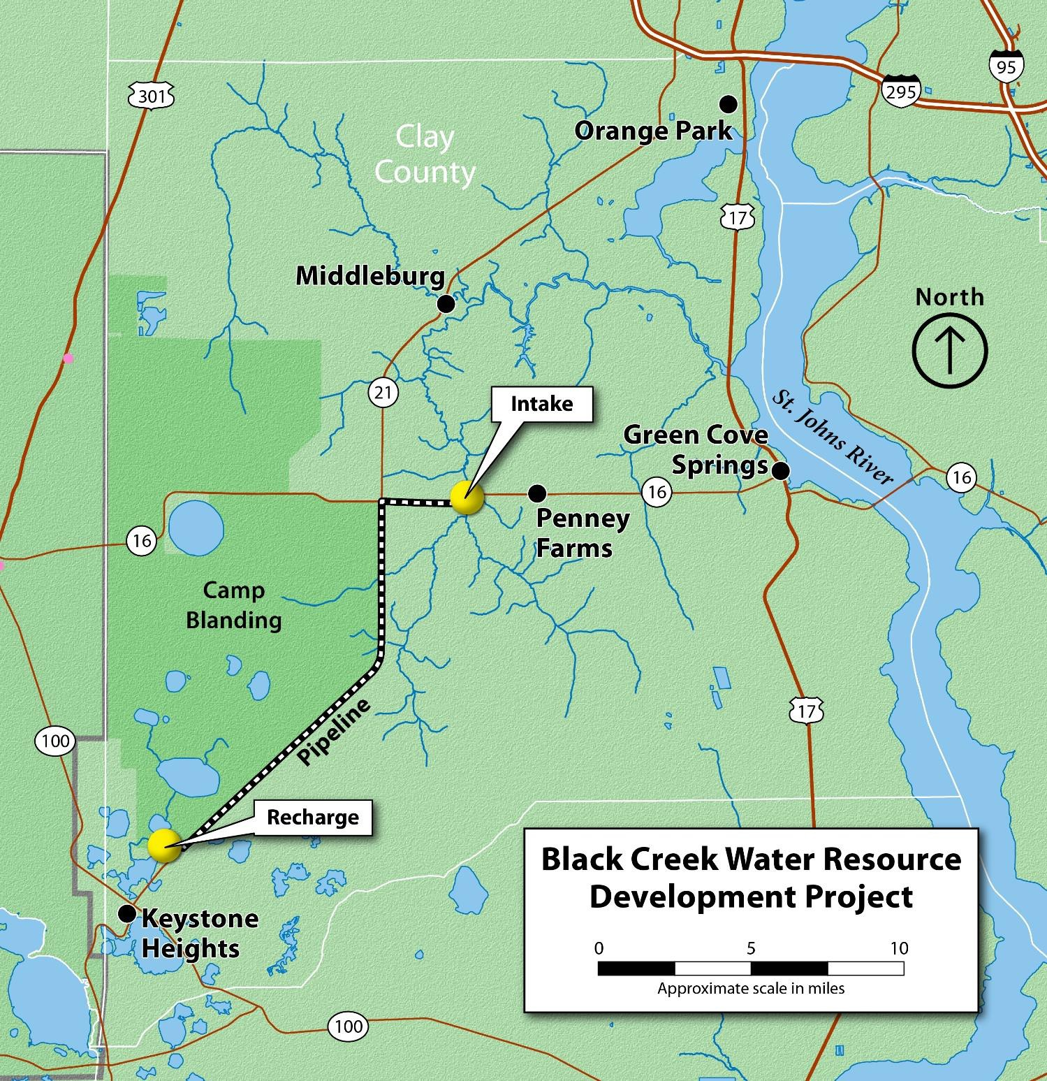
PROJECT OVERVIEW
10 mgd Intake Pump Station at South Fork Black Creek and SR 16 near Penney Farms
17-mile 30-inch Transmission Main
Regional Aquifer Recharge
Estimated Total Project Cost ~ $119M

Slide 14
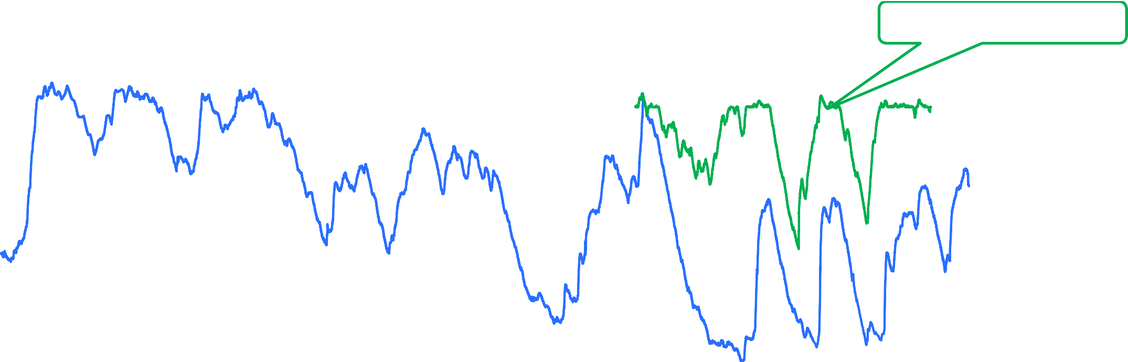
Lake Brooklyn Stages
Anticipated Lake Stage
with Project
120
115
110
105
100
95
90
85
Recorded Lake Stage, ft (NAVD 88)
113.7 ft
80
10/3/1954 6/11/1968 2/18/1982 10/28/1995
7/6/2009
3/15/2023
Project Operation — The pumps will be running only if:
There is adequate water in Black Creek.
If water levels in Lake Brooklyn are below 114.7 feet NGVD.

Slide 15
Lake Geneva Environmental Restoration Project
With Black Creek Project:
Normal Low Water Level (LWL)- 99.1 ft NAVD
Mean Water Level- 100.9 ft NAVD
Normal High Water Level (HWL)- 102.9 ft NAVD
a.k.a. Ordinary Water Level (OWL)
Source Data: CDM Smith Memo, Dated March 16,2022
Currently at 94 to 95 ft NAVD

Slide 16
Environmental Resource Permit (ERP)
Sponsor- Clay County
Authority- Florida Statute 18-21.004 (3) (b)- “when a governmental entity conducts restoration and enhancement activities, provided that such activities do not unreasonably infringe on riparian rights.”
Overseeing State Agency- Florida Department of Env. Protection (FDEP)
  Likely Delegated to Saint Johns River Water Management District (SJRWMD)
Sovereign Submerged Lands- Owned by the State of FL, Overseen by FDEP
Advocacy Efforts- Levels of FDEP, SJRWMD
Limitations:
  Trees and shrubs shall be cut off at the ground surface or higher
  Any removal of stumps, root raking or alteration to the soil surface is (strictly) prohibited
  Vegetative debris from the cutting will be removed from the (lakebed)
  Access within the (lakebed) for tree/vegetation removal shall not damage, alter the soil surface, or rut the (lakebed)

Slide 17
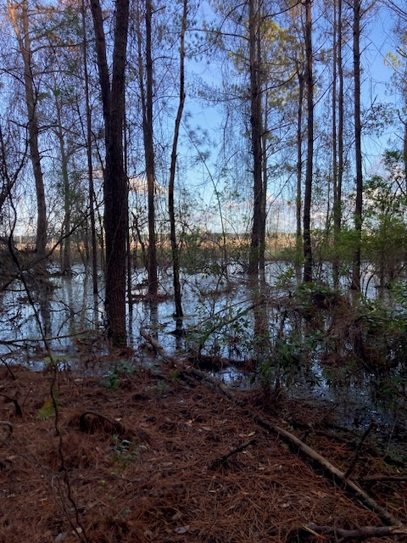
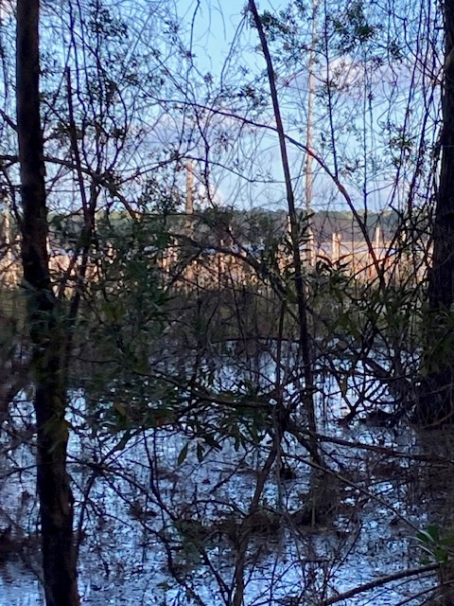

Slide 18
Lake Geneva Environmental Restoration Project (Slide 1)
Objective-Set conditions for the restoration of historic open water environmental habitat on Lake Geneva
  Removal of old growth forests that have grown in the lakebed over the last 50 years. Low water levels were caused by water demand on the aquifer from population growth.
  Removal of vegetative debris from the lakebed where economically feasible
  Target elevation is 102.9 feet North American Vertical Datum 1988 (NAVD88)
    Ordinary Water Level, aka Normal High-Water Level
    Goal is to remove trees and vegetive debris lower than 102.9 feet
    This would be the area where current trees will likely die as water levels return
    Some are already dying
    Restores environment to pre- 1970s conditions
    Reduces safety risks posed by submerged vegetation and floating logs throughout the lake
  Maps throughout the sanctuary show the 110-foot elevation in red marker. Ignore the 100-foot and 110-foot lines…software issue generated them. They are not significant to the project.

Slide 19
Lake Geneva Environmental Restoration Project (Slide 2)
  Landowners with property boundaries on the Clay or Bradford County map viewer that extend below the 102.9-foot elevation can opt out if they do not want that portion of the lakebed restored
    Please get us your contact information
    Send us an email letting us know if you do not wish to participate in the restoration (save-our-lakes@comcast.net)
    We will coordinate with the contractor to avoid the property boundaries indicated in the County map viewer system
    Understand that these areas will not be readdressed later. This is a one-time effort
  The contractor may be able to support landowners who wish to have their private property timbered upland/above the 102.9-foot elevation
    Please ensure we have your contact information
    Please send us an email requesting this action and we will work to connect you with the contractor (save-our-lakes@comcast.net)
    This action would be between the contractor and landowner and not part of the restoration project
  We are working to obtain elevation data for the 52 parcels of land in Bradford County

Slide 20
Current Targeted Areas

Slide 21
Way Forward
  Rough Timeline:
    30 January 2025- Landowners Meeting
    7 to 21 February 2025- Clay County Submits ERP to SJRWMD for review
    14 February to 14 March- SJRWMD/FDEP ERP Approval
    Mandatory 21-day ERP advertisement in local paper for public comment
      Start between 14 February and 4 April 2025
    11 March to 11 April 2025- Begin Contractor Procurement Period
    1 April 2025- Early Contractor Start (Estimate 4-week period of performance)
    29 April 2025- Early Contractor Finish
    12 May 2025-Late Contractor Start
    9 June 2025- Late Contractor Finish

Slide 22
Pre-Submitted Q&A #1
Question-Hello, I live on the headwaters of Lake Geneva. It is a smaller, spring fed lake, that feeds into the rest of Geneva through a small creek. Since I moved here in February of 2014, the water levels have been stable and have come up slightly in recent years. Several people on the lake have rebuilt docks to adapt to the current level, and now this man made restoration threatens to submerge our new docks. I understand the need to raise the water levels on the large area of Geneva, but why are you trying to raise the levels to what they were in the 1960s? Our water levels have been fairly stable for decades and we will see no benefit from increased levels, only destruction of our property.
Answers-
1)The stable, to rising, water levels you have seen since 2014 has likely been due to a wet cycle for Florida. A dry cycle will come and bring levels down if not mitigated by the Black Creek flows.
2) Water demands on the Floridian Aquifer are expected to increase by 135 million gallons per day (mgd) for the region through 2045. Lake Geneva is at the top of that mountain of groundwater. Lakes Brooklyn and Gerneva represent one of only two recharge points for the Upper Floridan Aquifer. The second is all the way up near Valdosta, GA. Without water resource development projects like the Black Creek Project the lake region will see reduced lake levels from this water supply demand.
3) If you have built docks under the current conditions and they are in the water, there is a high probability that the structure is on State Sovereign Submerged Land, permitted by the State of Florida, and subject to State of Florida’s decisions (based on public feedback) on how to manage resources for the grater good of all citizens.

Slide 23
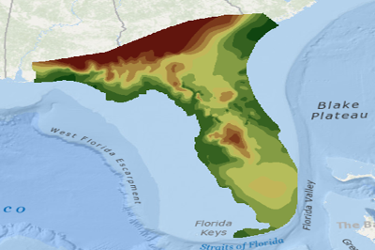
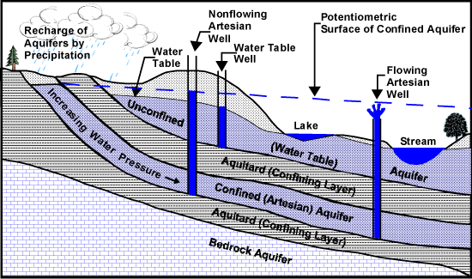
Upper Floridian Aquifer Potentiometric Surface Map
Keystone Heights
Upper Floridan Aquifer Potentiometric Surface May 2017 | Florida Department of Environmental Protection Geospatial Open Data

Slide 24
Pre-Submitted Q&A #2
Question- Are there any plan to clean up the lily pads and vegetation from the lake? It’s spread out 2-300 yards in all directions. I hope you can address this issue at the meeting.
Question- I am unable to attend the meeting on January 30th but would like to have addressed the problem of what to do with all the grass/weeds that have grown up along the lake edges. It seems that a mass of dead low vegetation when covered up by rising waters would not be healthy for the lakes. Removal will probably be left up to individual owners and should require some consistent direction to avoid use of poisons or other destructive measures of removal.
Answer-
  There are no plans from this body of organizations to address the removal of lily pads or water weeds. Individual landowners my apply for licenses and permits to address weeds and vegetation through the Fish and Wildlife Conservation Commission (FWCC) who should provide consistent guidance on the issue. Some actions do not require permits. https://myfwc.com/license/aquatic-plants/ or sharon.stinson@myfwc.com or (863) 534-7074

Slide 25
Pre-Submitted Q&A #3
Question- My neighbor at the lake asked if I knew what the number was above sea level when Geneva would be at peak? Is there high-water set level number before the water would go to the outfall leading on to Old Field pond? I think he is trying to gauge how much he would need to raise his dock.
Question- My neighbors and I have concerns that the outflow might not be at the same elevation that it was in the 70s due to erosion and other manmade factors. Has anyone surveyed the outflow to verify elevations? On that same note, I recall you mentioning in the SOLO meeting that there is a concrete box culvert on the outflow of Brooklyn. I don’t think we have one here on Geneva. Is that something that can be added to ensure our homes don’t get flooded here on Geneva?
Answer- The controlling structure for water to flow out of Lake Geneva is a set of four48 inch culverts under County Road 214. These were not assessed in 2022 as needing any maintenance. There is a culvert at Gustafson Road that is silted in and needs de-silting or potential a replacement. Clay county is aware of the maintenance need. Water begins to flow through them when the lake is at, or above, 104.4 feet NAVD 88. Since the Normal high-water level of the lake will be 102.9 feet NAVD 88, and SJRWMD will turn off Black Creek project flows if Lake Geneva exceeds 103 feet NAVD, flow toward Oldfield Pond will likely only occur under flooding conditions that raise the lake 1.4 feet over the normal high- water level. For reference, the 100-year flood elevation for Lake Geneva is 106.1 feet NAVD.
  Reference Slide #11 “Lake Geneva Stages” for a visual of how this compares to historic flows.

Slide 26
Pre-Submitted Q&A #4
Question- My question for the 1-30 SOLO meeting is whether the Lake Geneva lobe we are on that is currently blocked from access to the other lake lobes by tree growth will be also cleared as part of Lake Geneva Restoration project permitting?
This is the now wooded section between Breezy Point and Alderman Rd. which is state land. It has been grown over without access for over 40 years after the lake water receded.
Answer-Yes. We are looking to clear this area of trees and vegetation.

Slide 27
Pre-Submitted Q&A #5
Question- The issue with the water draining from west to east concerns me ,as the parts of the lake on S.E. 35th st and 2nd ave, and also the Alderman Rd portion have dropped considerably while the other portions of the lake bed rise. These were always the highest points of the lake until the last few years..I have heard and know that someone has created a ditch for it to drain that way…What are we going to do to address this issue…
Answer- The Lake Geneva Environmental Restoration Project’s goals were spelled out above. We do not intend to address any of the numerous man-made channels/ cuts throughout the Lake. This project takes a multi-year vision and sees most, if not all, of those man-made cuts submerged when the Lake is between its expected levels of 99.1 to 102.9 feet NAVD. This would be a minimum of 4 to 5 feet deeper than current levels.

Slide 28
Pre-Submitted Q&A #6
Question-Baker Rd. landowner owner is very concerned about the potential for increased property taxes. They have never considered themselves as lakefront property owners as they thought they basically had State Forest Land behind them (only been in the house a few years). They were concerned about being reclassified as lake front owners and potential tax implications.”
Answer-Clay County Property Appraiser , Mr. Tracy Drake, will address this question in person at the meeting.

Slide 29
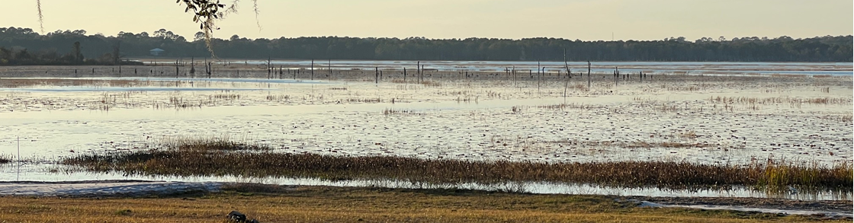
Pre-Submitted Q&A #7
Question- In the last SOLO meeting, you said that the timber company was able to get trees up to 3’ deep. I’m here on the SE corner of Geneva and looking at the attached picture to this email, we have trees from the old island sticking up that are already over 200 yards from the shoreline. As the water comes up more, those trees will be just under the waterline and would be very dangerous to anyone that is not familiar with our lake. It could take off a prop off of a boat or severely hurt a tuber that is unlucky enough to fall on one just below the surface. My question is, is there any way those could be knocked down by another company so they would not be a water hazard? If that is not possible, could they be cut at the current waterline and marked with PVC for now so they will be 10’ underwater when the lake comes up?
Answer-

Slide 30
Pre-Submitted Q&A #8
Question-
Answer-

Slide 31
In person Questions?
During Q&A, please do not speak over folks asking questions or the person answering the questions.
  Please limit any comments or questions to 2-3 minutes so we can answer and then get to as many other questions as possible.
  If you have concerns with the answer, ask one follow up question and then follow up with the responder after the meeting.
  If we do not have an answer for your question, we will note it and seek an answer for you.

Slide 32
Conclusion
Contact Information / Links:
SOLO- save-our-lakes@comcast.net
Clay County Map Viewer
City of Keystone Heights website
  https://www.keystoneheights.us
  “News” Tab for this slide deck
Photo from 1953
Recent Photo

