Slide 1
Lawrence Boulevard Streetscape Improvements
City Council Presentation
January 20, 2022

Slide 2
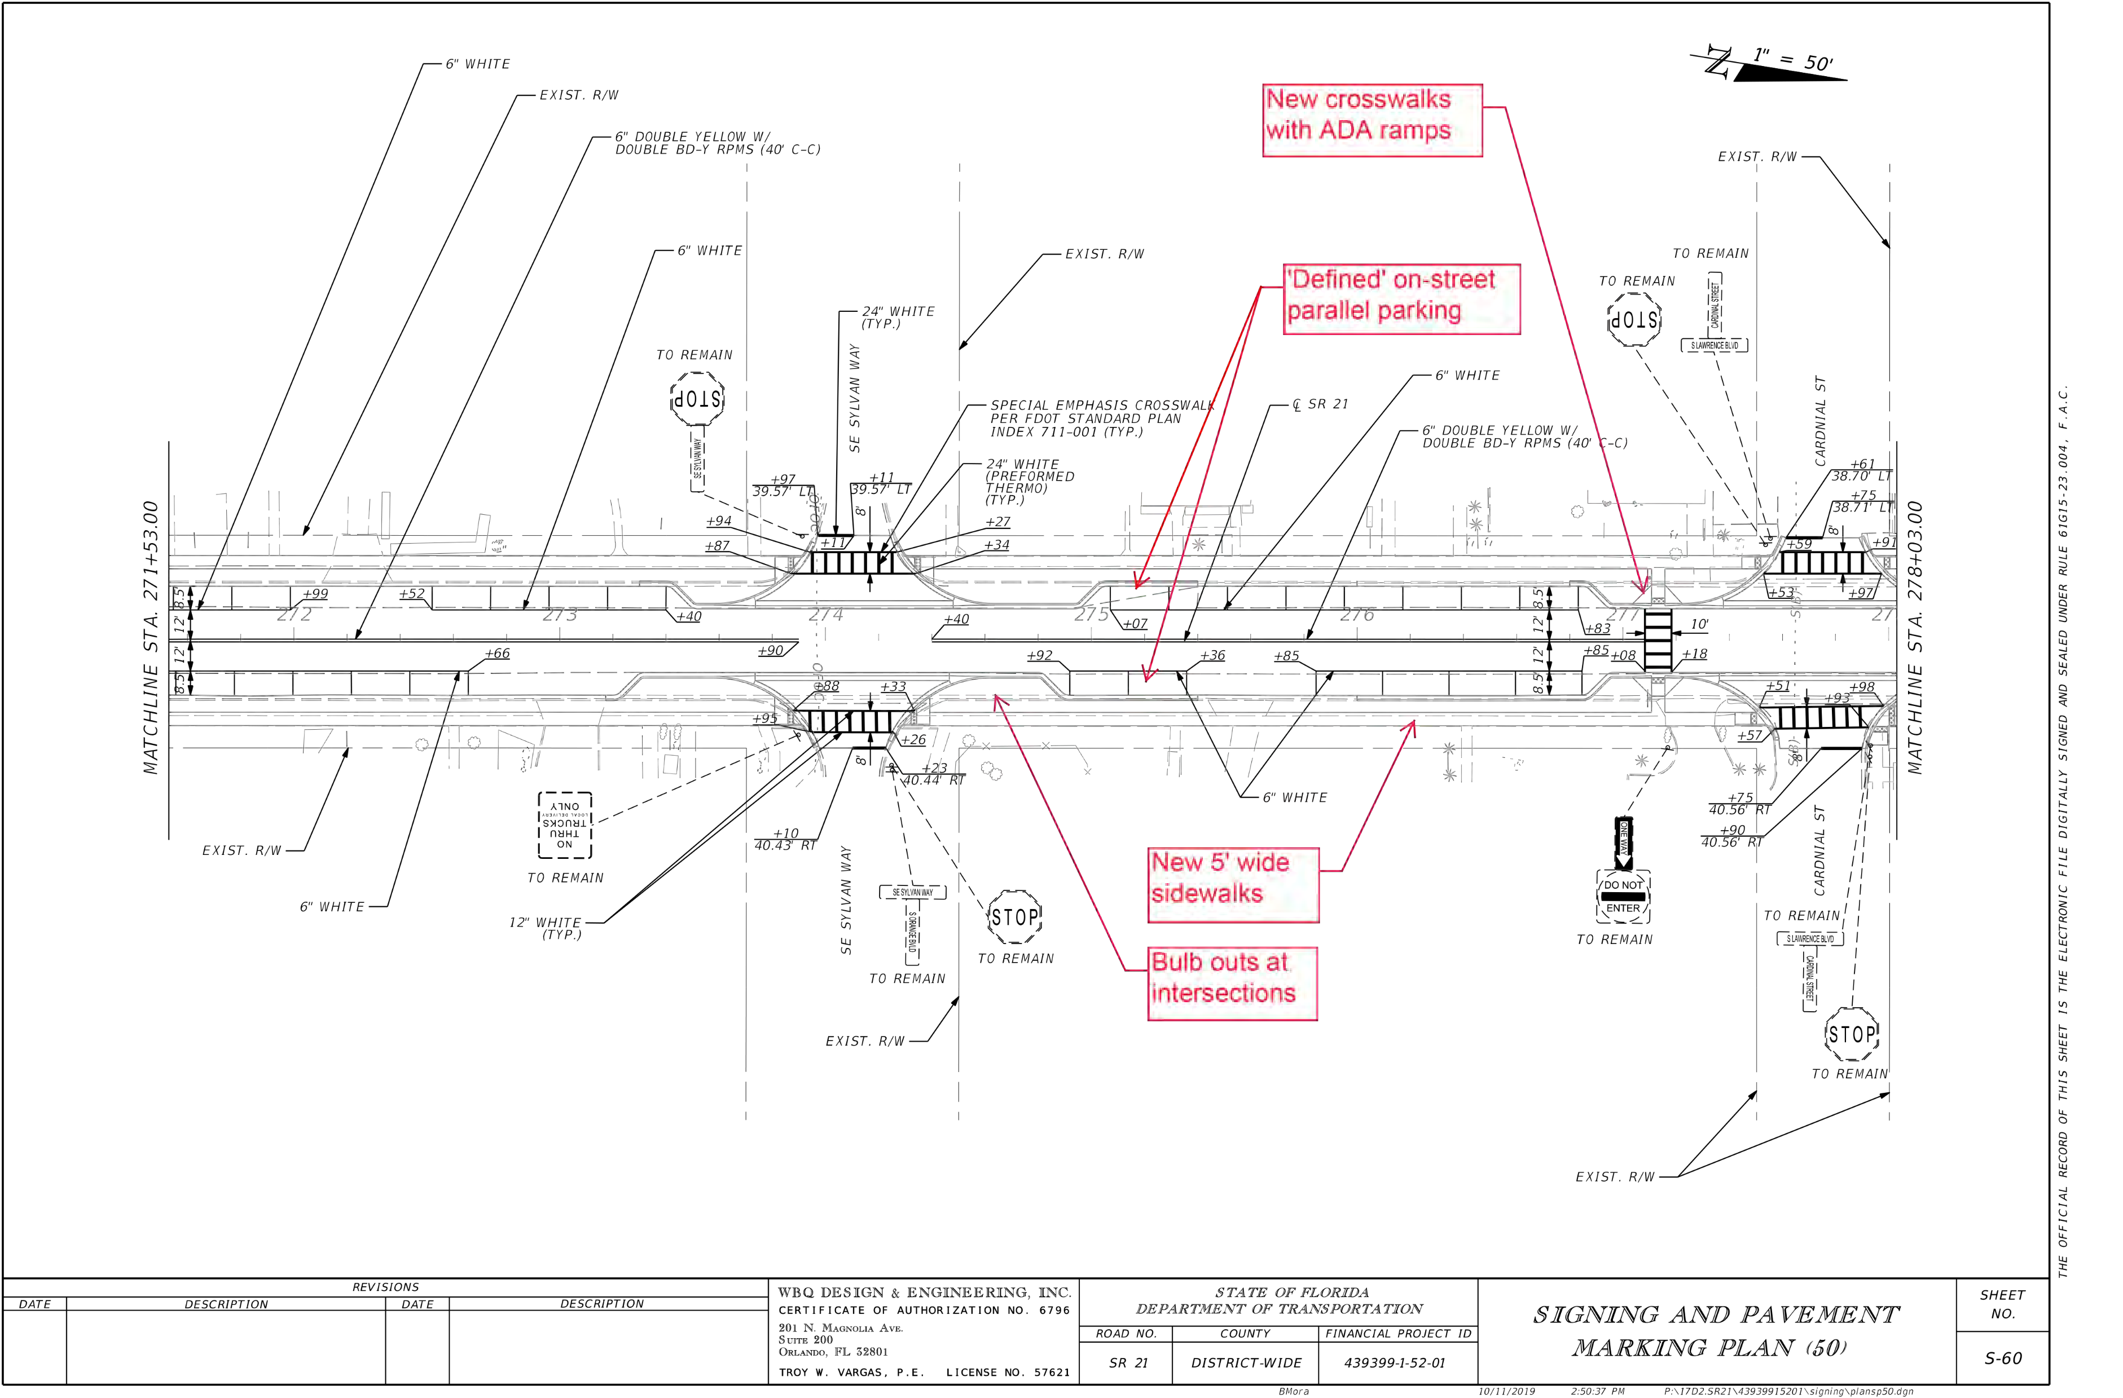
FDOT Summary of Work:
Mill and resurface
Improve the safety of the roadway by…
widening the paved shoulders
improving lighting
adding mid-block crossings and bulb-outs
signal and pedestrian improvements at the intersection with SR-100
FDOT SR21/ Lawrence Blvd. Improvements
Keystone Heights Lawrence Boulevard Improvements
January 20, 2022
2

Slide 3
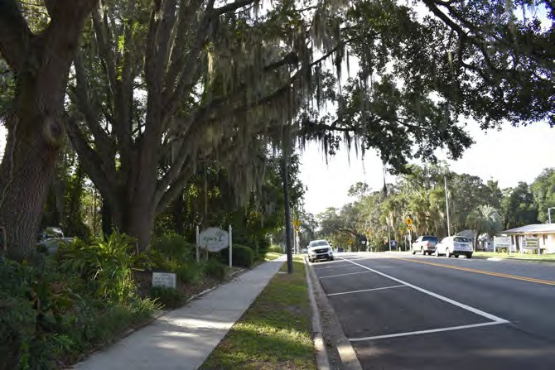
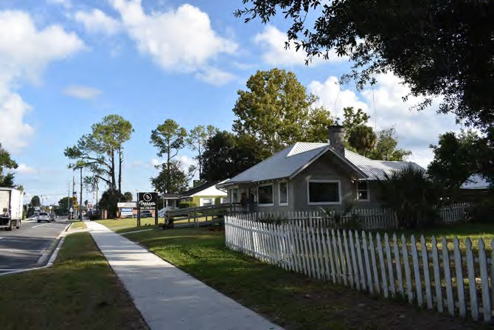
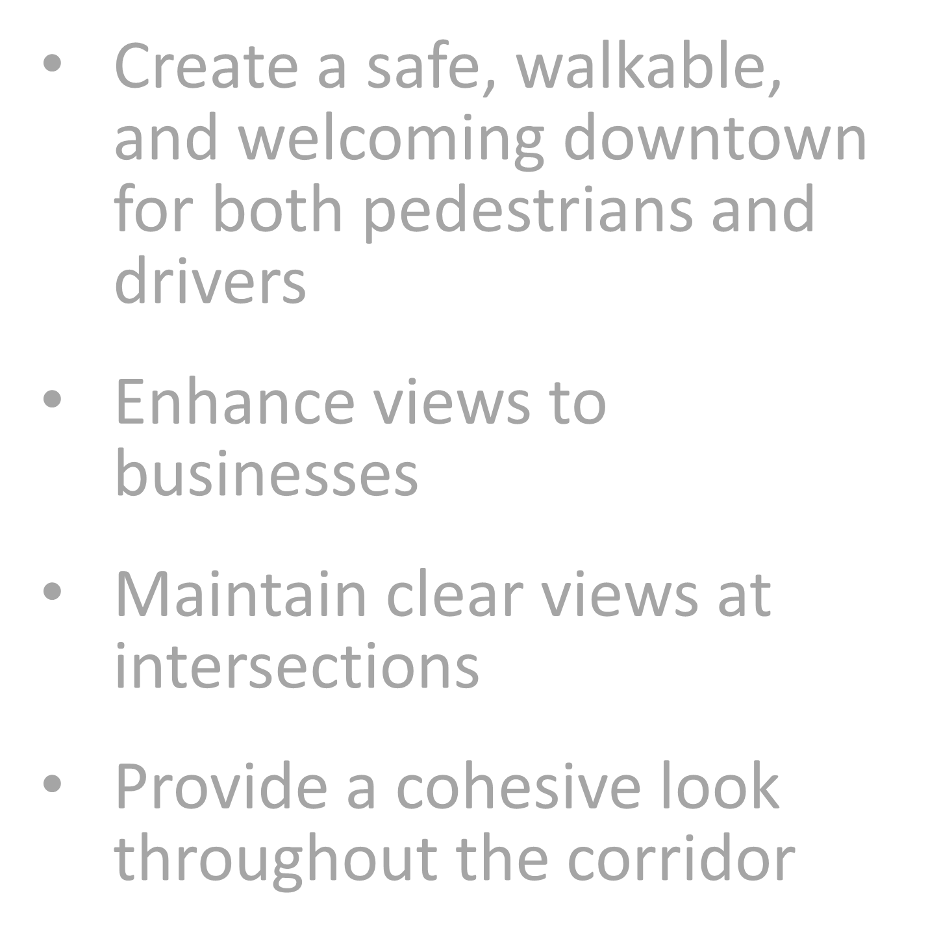
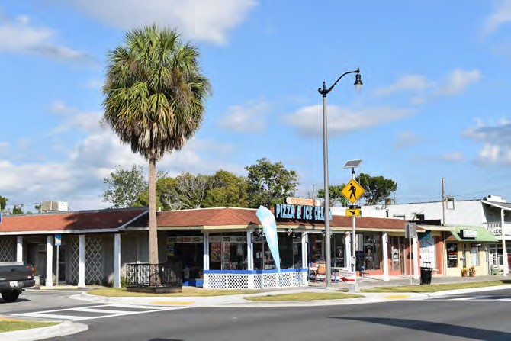
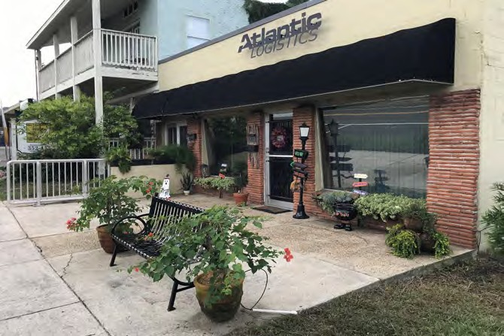
Goals
Create a safe, walkable, and welcoming downtown for both pedestrians and drivers
Enhance views to businesses
Maintain clear views at intersections
Provide a cohesive look throughout the corridor
Design Vision
Keystone Heights Lawrence Boulevard Improvements
January 20, 2022
3

Slide 4
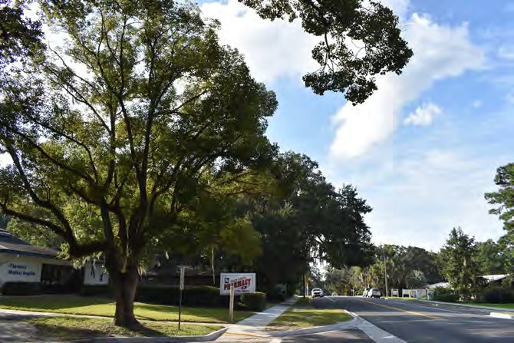
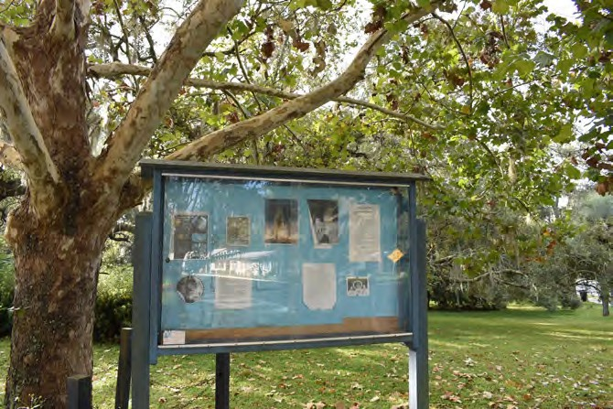
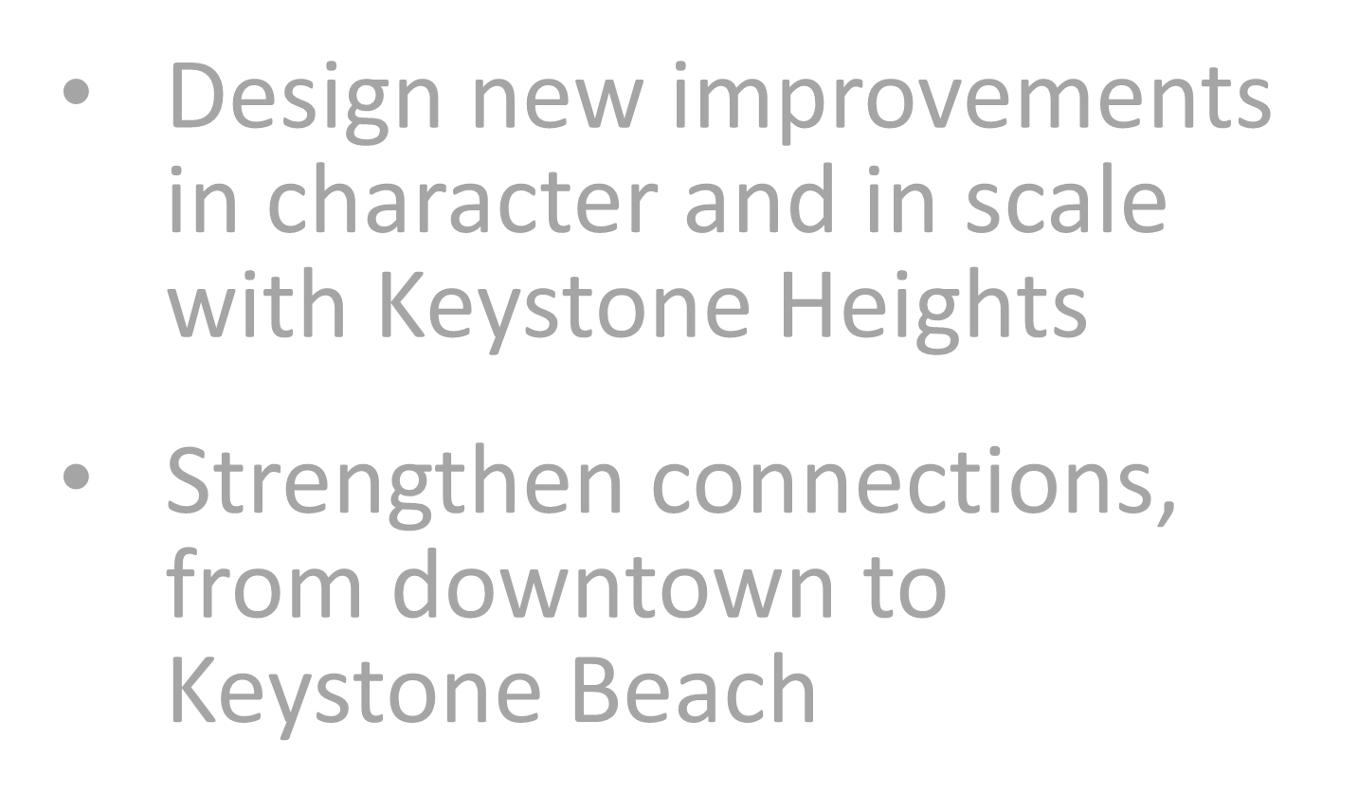
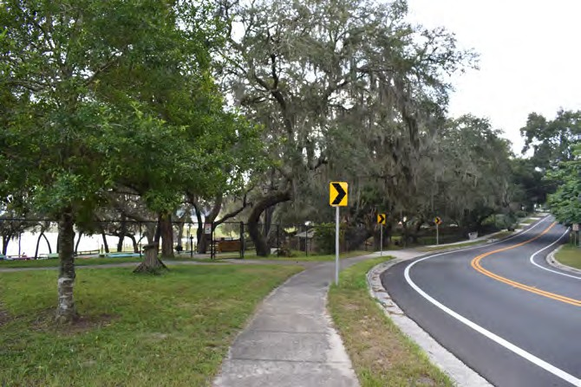
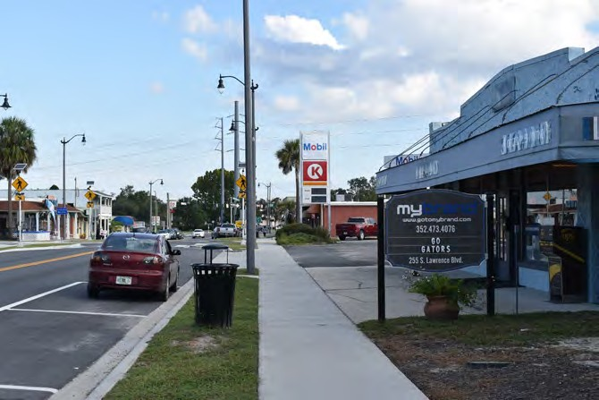
Goals, cont.
Design new improvements in character and in scale with Keystone Heights
Strengthen connections, from downtown to Keystone Beach
Design Vision
Keystone Heights Lawrence Boulevard Improvements
January 20, 2022
3

Slide 5
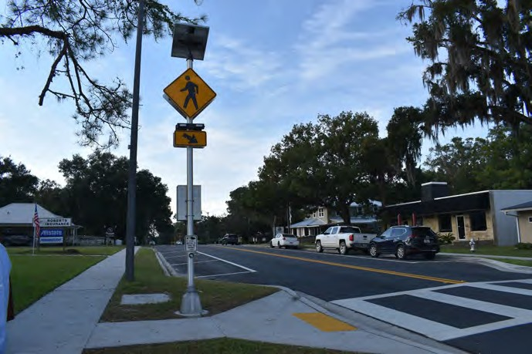
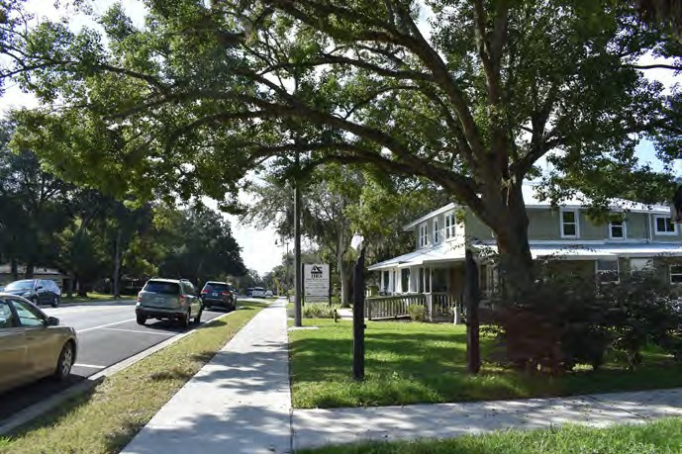
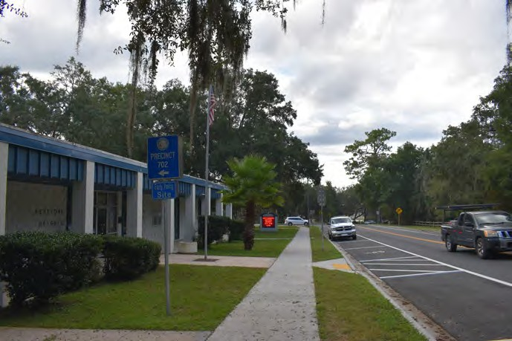
Add to existing roadway improvements
Building on existing character & charm
Connect to civic spaces
Opportunities
Keystone Heights Lawrence Boulevard Improvements
January 20, 2022
5

Slide 6
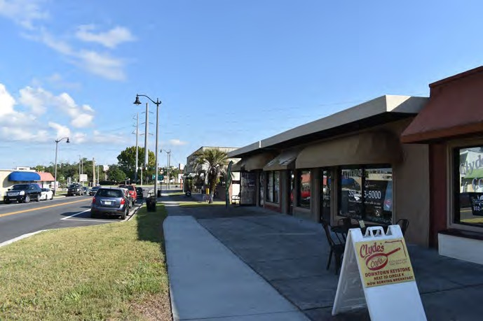
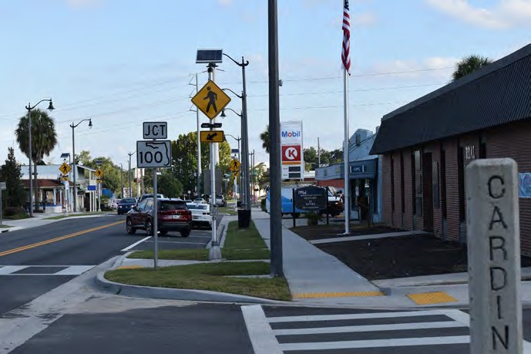
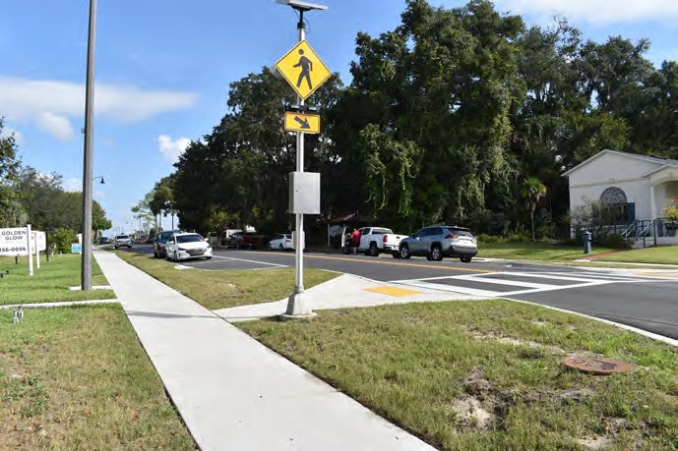
Define comfortable scale and outdoor use areas
Lessen visual clutter as possible
Improve access and connectivity
Possibilities
Keystone Heights Lawrence Boulevard Improvements
January 20, 2022
6

Slide 7
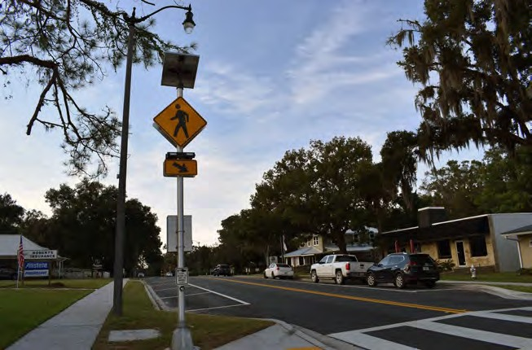
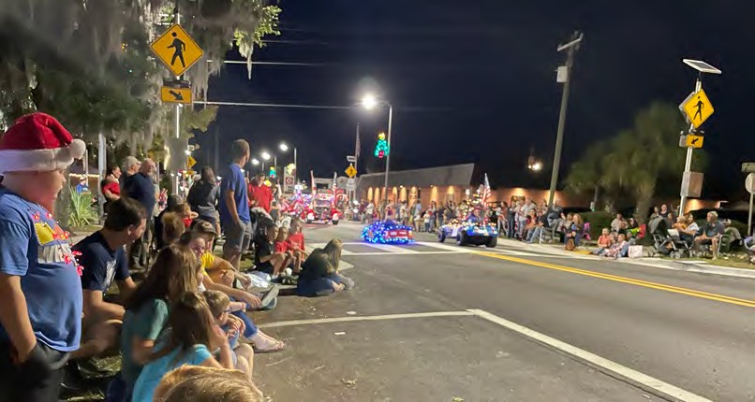
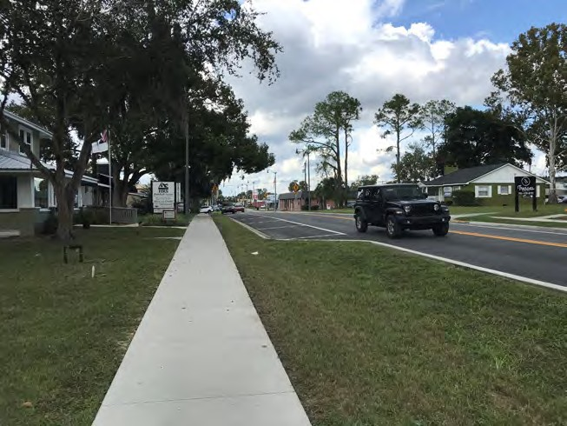
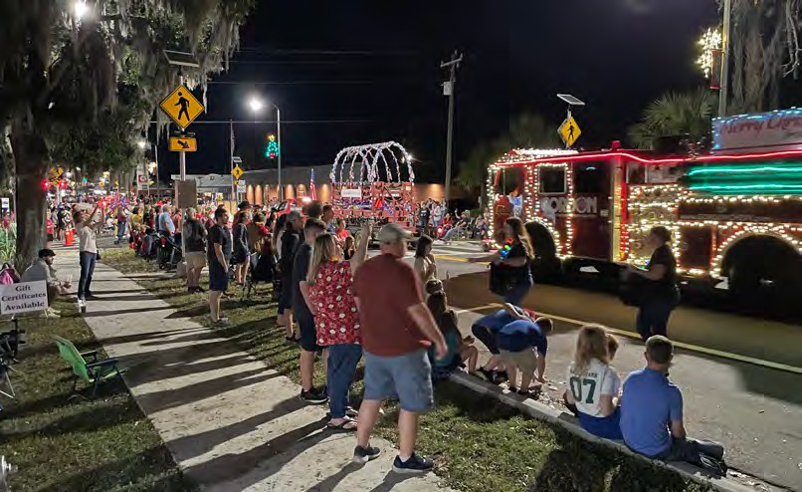
Typical:
Parade:
Everyday Use vs. Event Days
Keystone Heights Lawrence Boulevard Improvements
January 20, 2022
7

Slide 8
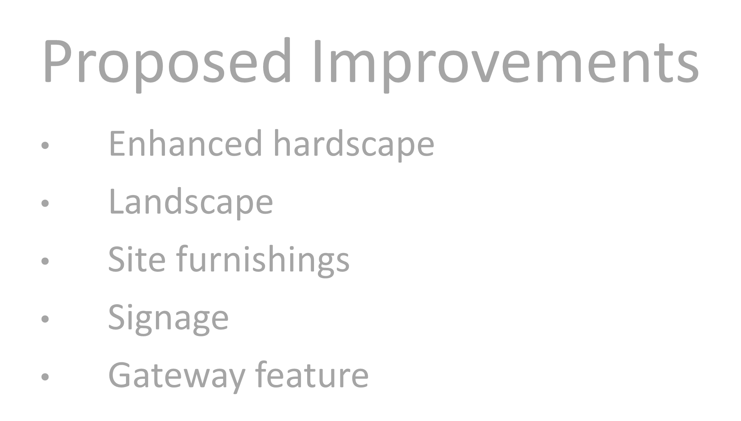
Proposed Improvements
Enhanced hardscape
Landscape
Site furnishings
Signage
Gateway feature
Types of Improvements
Keystone Heights Lawrence Boulevard Improvements
January 20, 2022
8

Slide 9
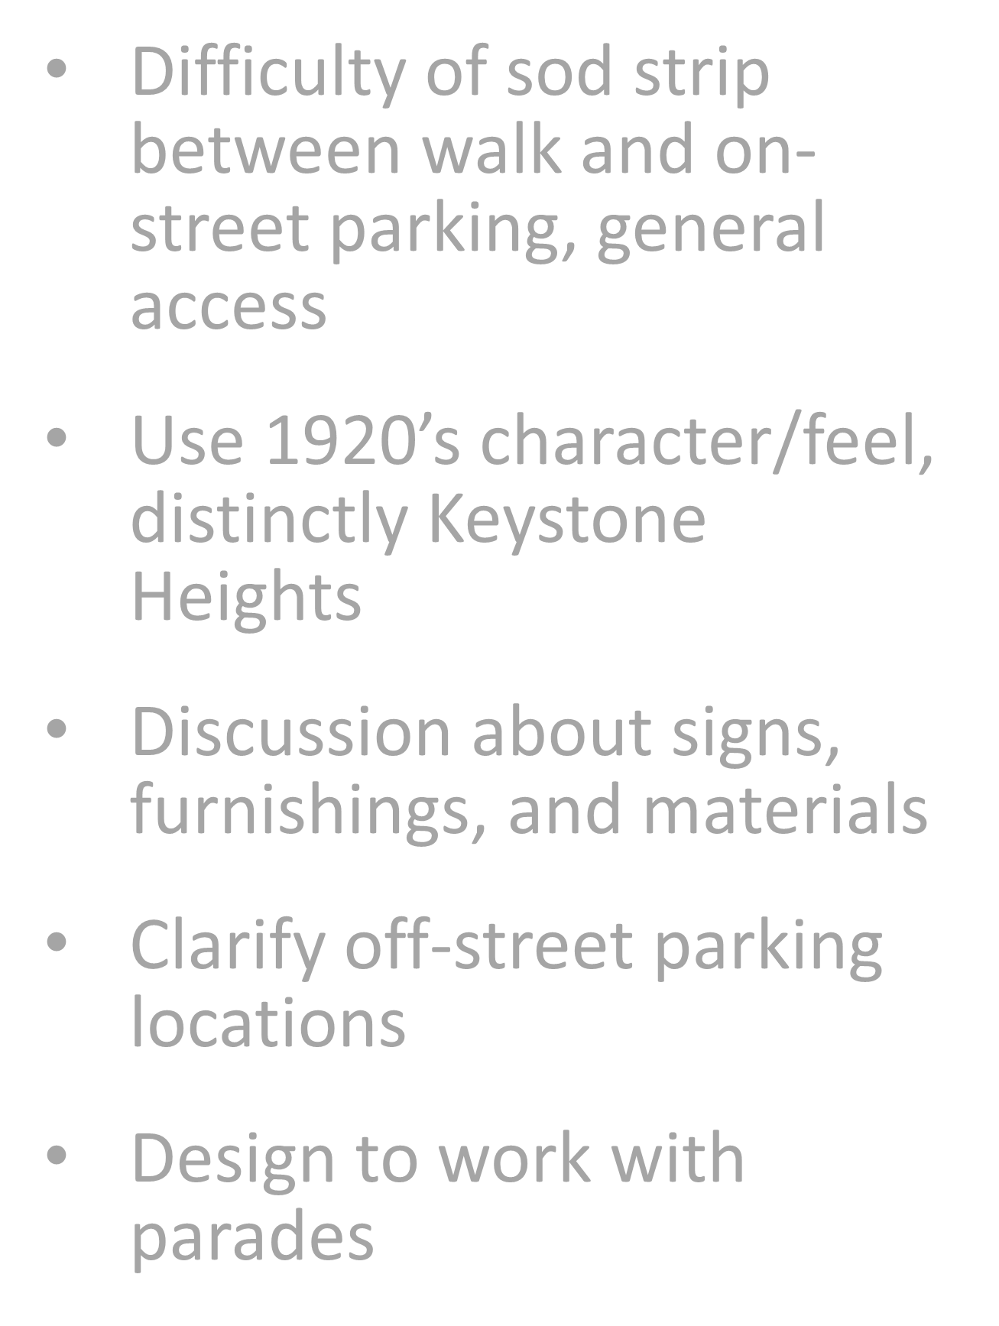
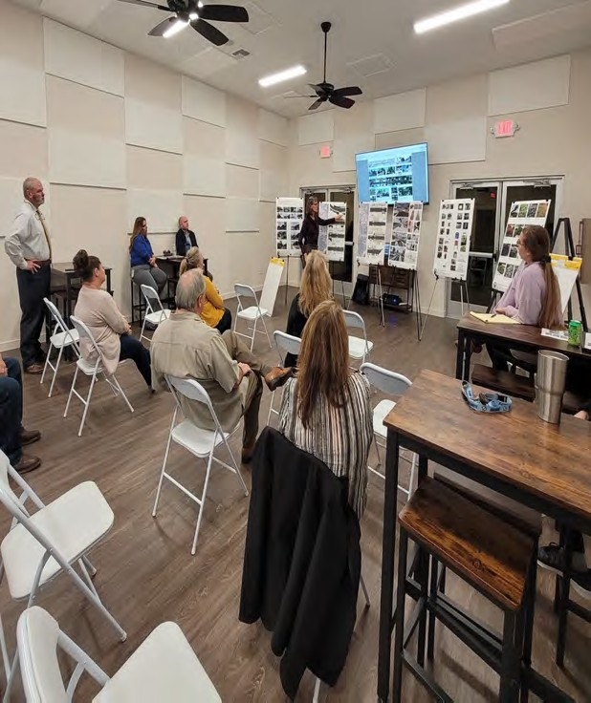
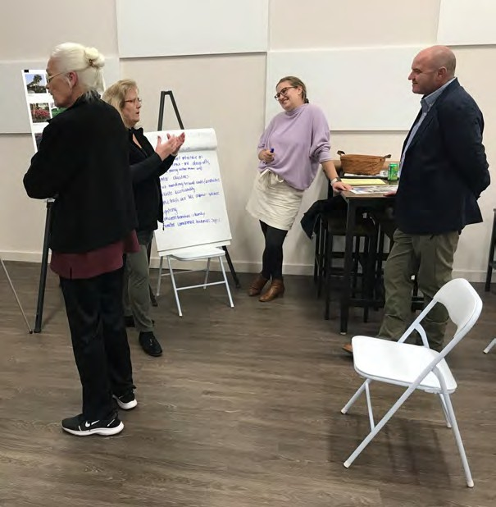
Open House, Nov. 8
Heritage Commission and Business Owners
Difficulty of sod strip between walk and on- street parking, general access
Use 1920’s character/feel, distinctly Keystone Heights
Discussion about signs, furnishings, and materials
Clarify off-street parking locations
Design to work with parades
Input to Date
Keystone Heights Lawrence Boulevard Improvements
January 20, 2022
9

Slide 10
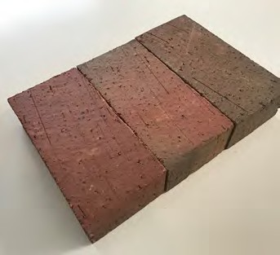
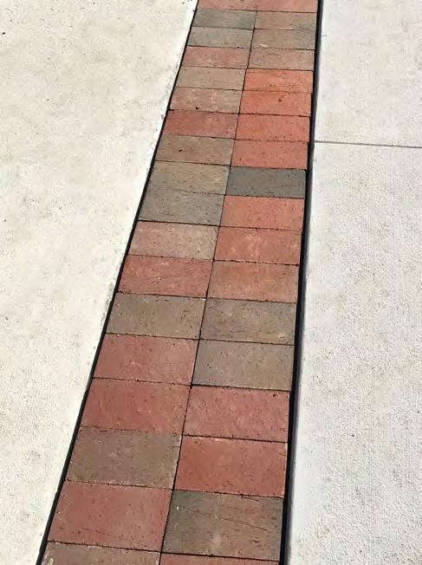
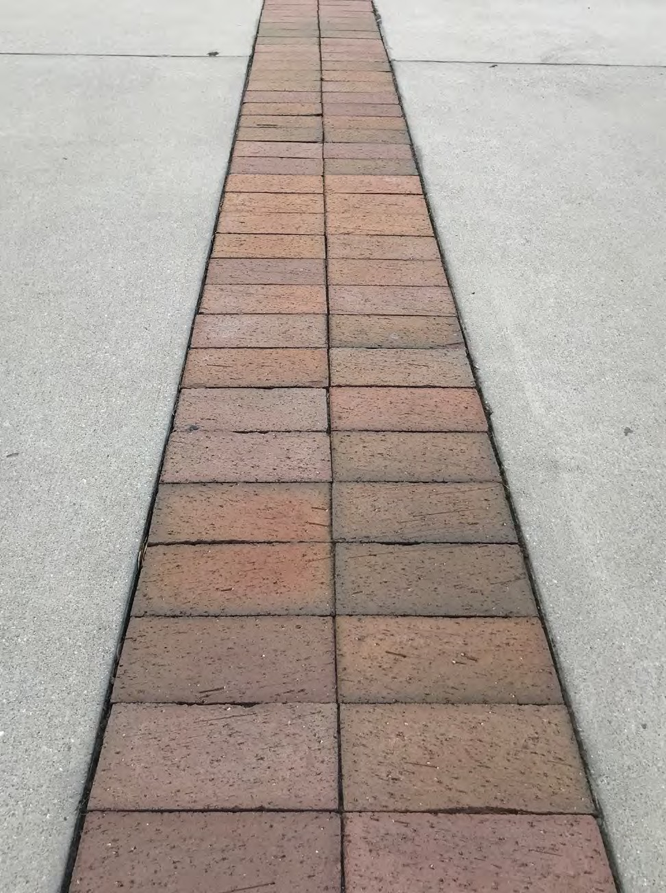
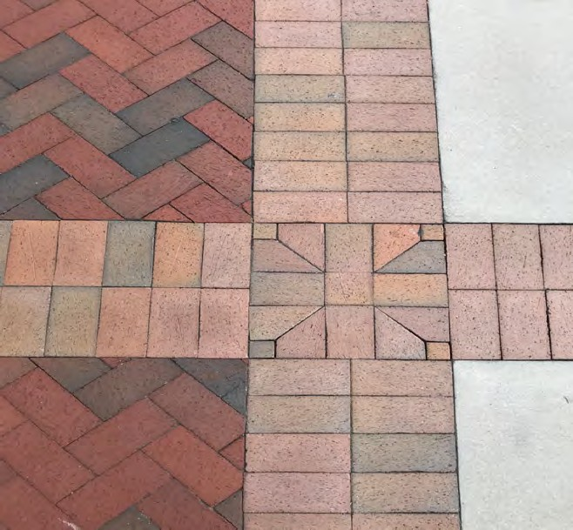
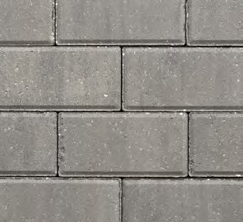
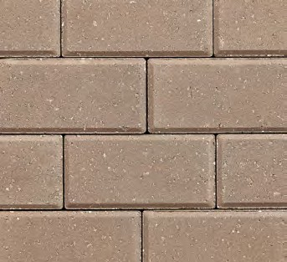
Proposed Paving Material Options
Hardscape
Keystone Heights Lawrence Boulevard Improvements
January 20, 2022

Slide 11
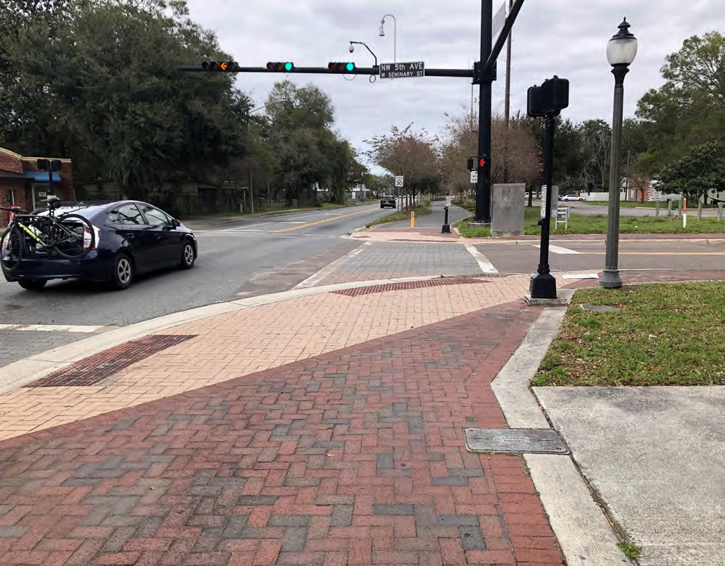
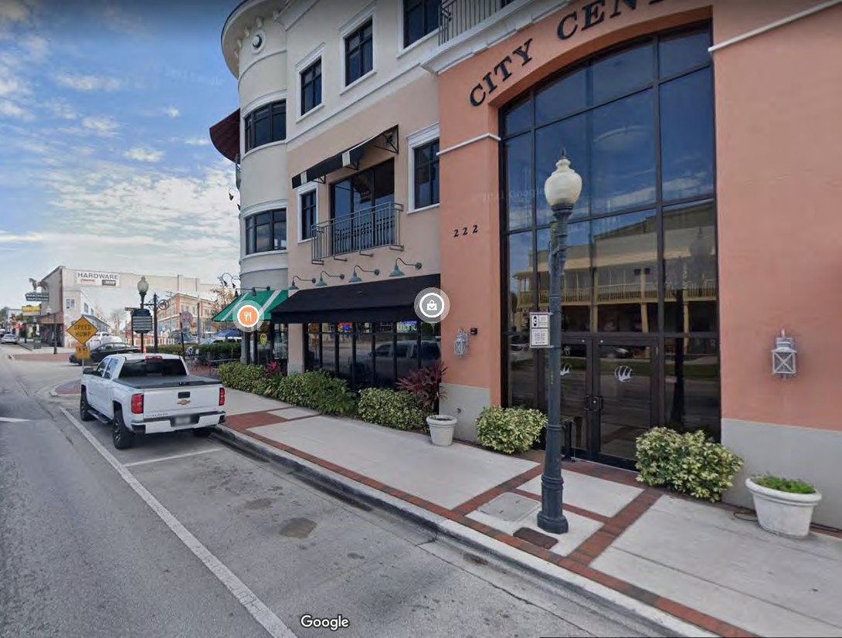
Paving Approaches
Hardscape
Keystone Heights Lawrence Boulevard Improvements
January 20, 2022

Slide 12
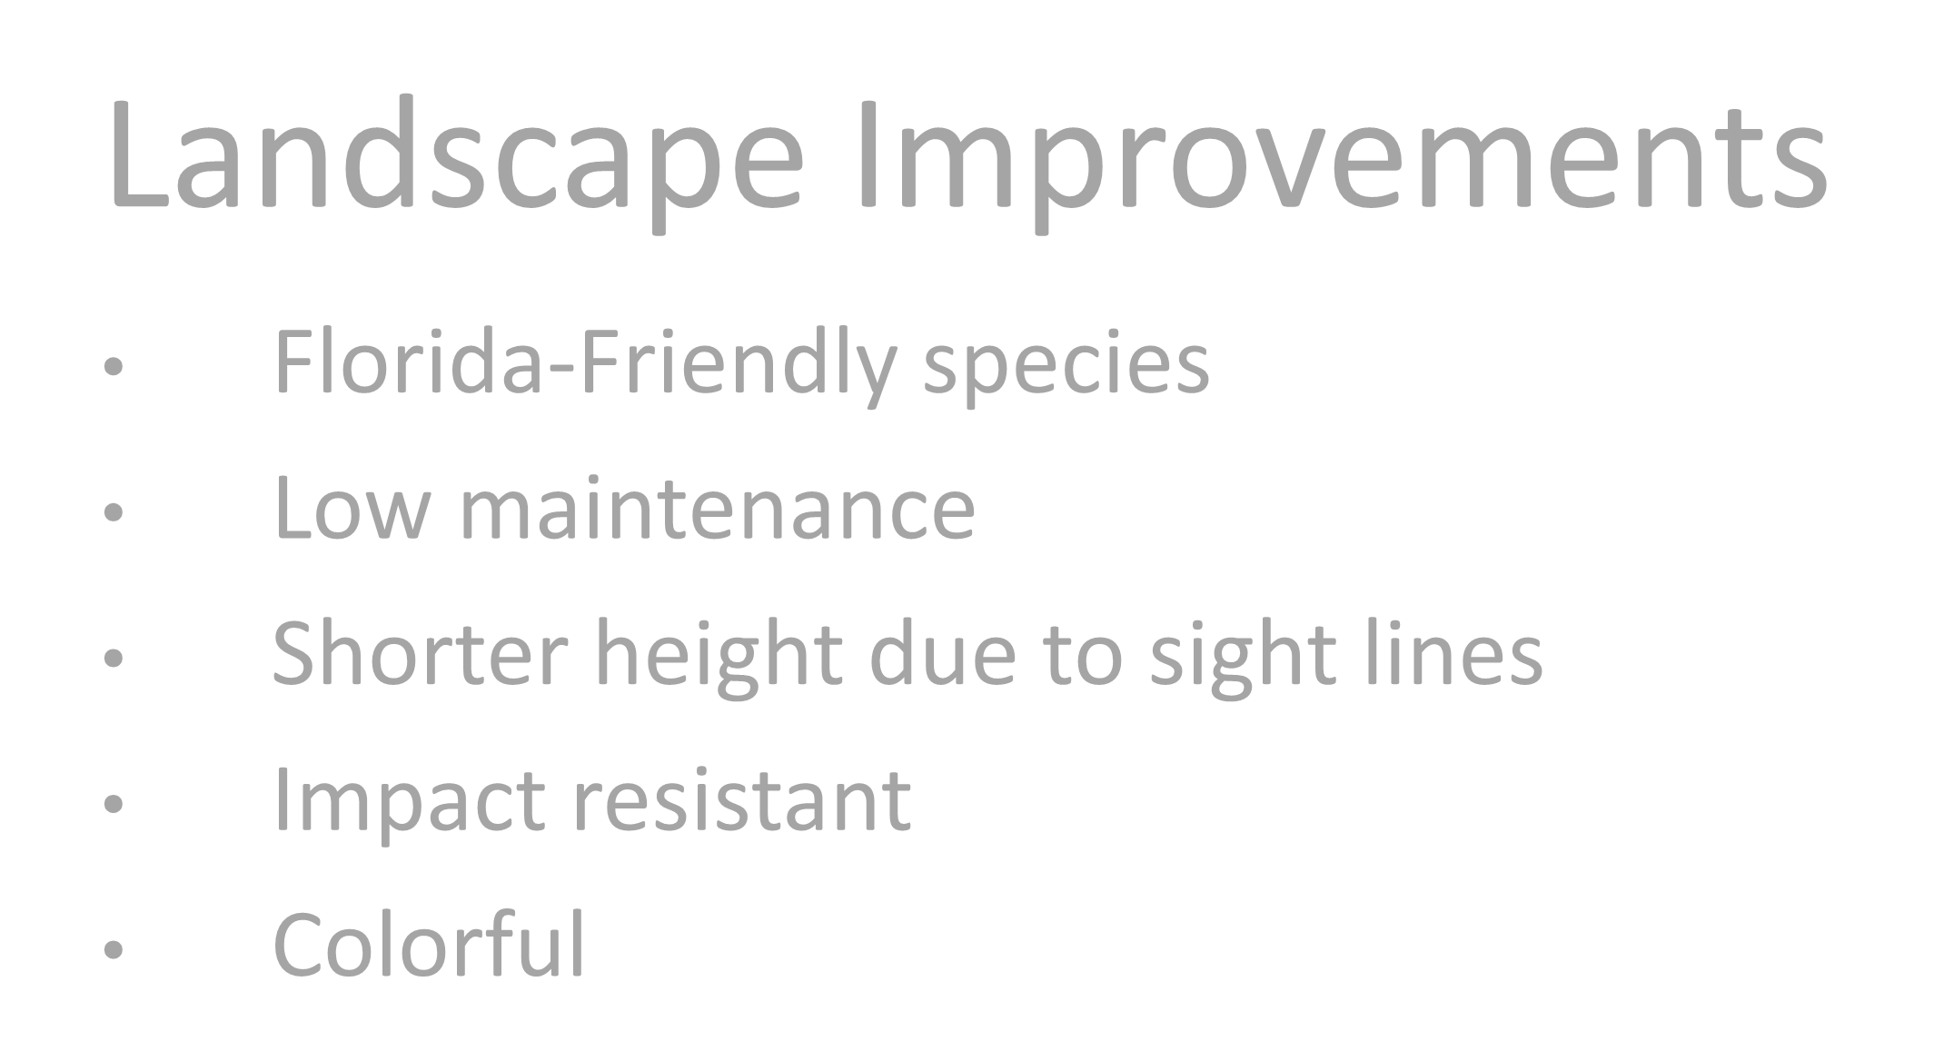
Landscape Improvements
Florida-Friendly species
Low maintenance
Shorter height due to sight lines
Impact resistant
Colorful
Landscape
Keystone Heights Lawrence Boulevard Improvements
January 20, 2022

Slide 13
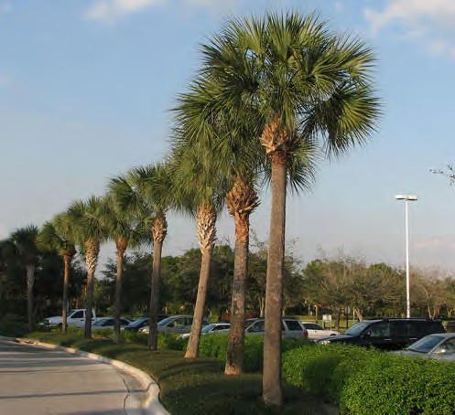
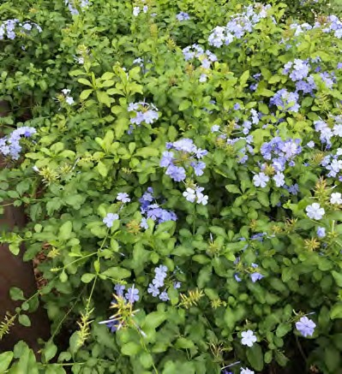
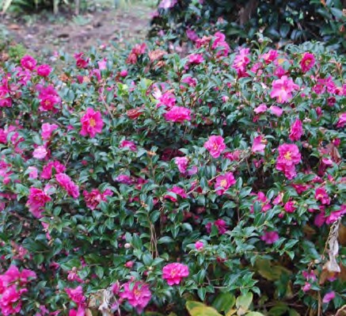
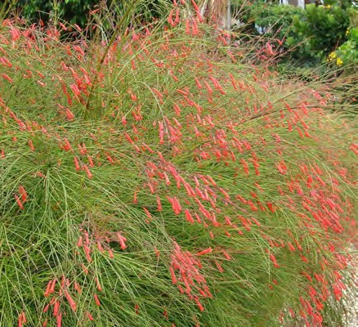
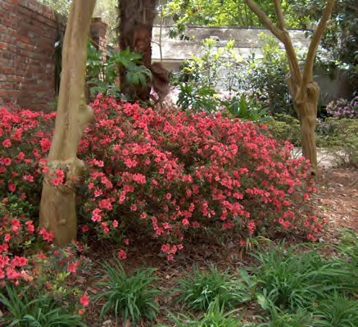
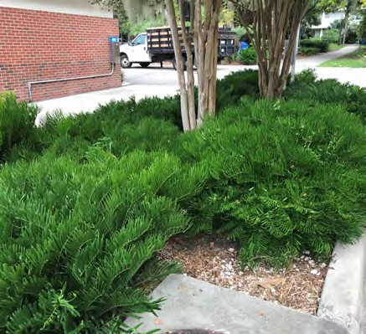
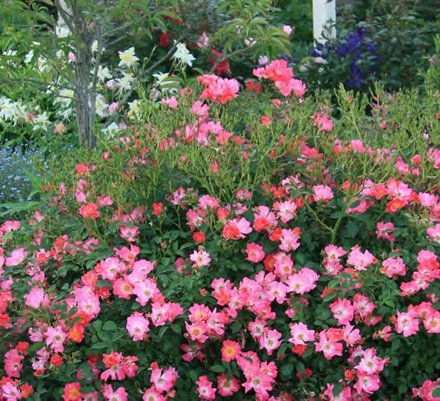
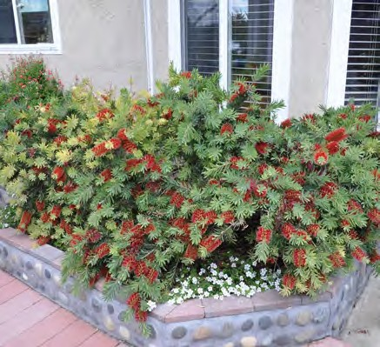
Sabal Palm
Sabal palmetto
Plumbago
Plumbago auriculata
Shishi Gashira Camellia
Camellia sasanqua ‘Shishi Gashira’
Fountainbush
Rusellia equisetiformis
Fashion Azalea
Rhododendron x ‘Fashion’
Coontie
Zamia pumila
Coral Drift Rose
Rosa x ‘Coral Drift’
Little John Bottlebrush
Callistemon viminalis ‘Little John’
Landscape
Keystone Heights Lawrence Boulevard Improvements
January 20, 2022

Slide 14
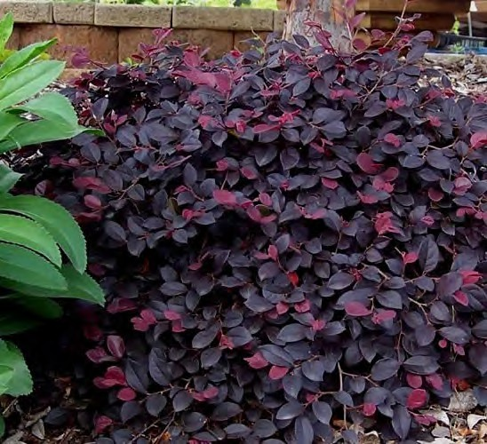
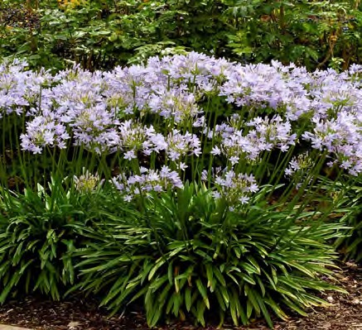
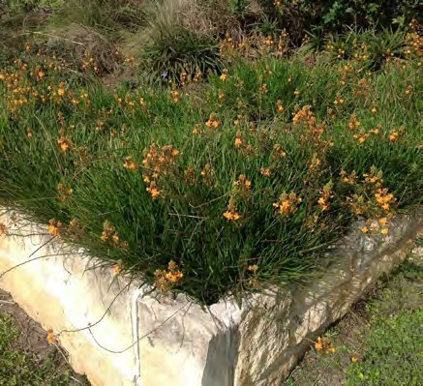
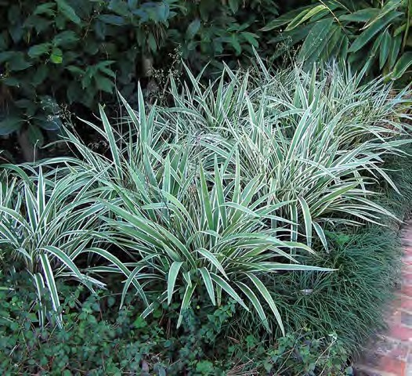
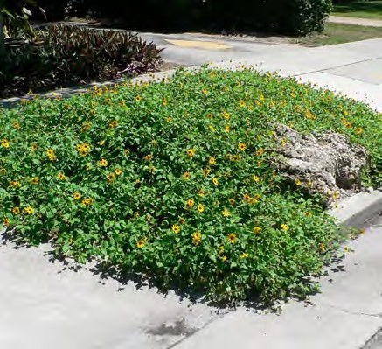
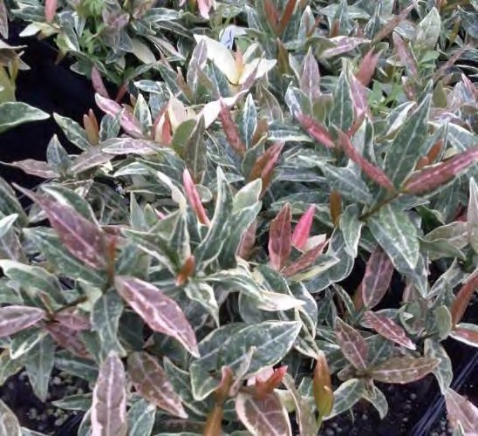
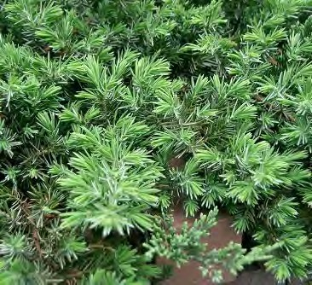
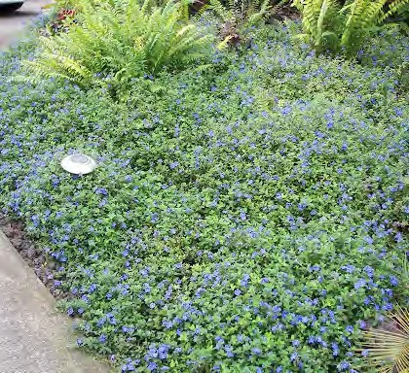
Chinese Fringe Bush
Loropetalum chinense
Agapanthus
Agapanthus africanus
Bulbine
Bulbine frutescens
Flax-Lily
Dianella tasmanica
Dune Sunflower
Helianthus debilis
Tri Color Asiatic Jasmine
Trachelospermum asiaticum ‘Tri Color’
Blue Pacific Juniper
Juniperus conferta ‘Blue Pacific’
Dwarf Morning Glory
Evolvulus glomeratus
Landscape
Keystone Heights Lawrence Boulevard Improvements
January 20, 2022

Slide 15
Site Furnishings
Purchased Signs
Existing Signs
New Street Name Detail
Site Furnishings & Signs
Keystone Heights Lawrence Boulevard Improvements
January 20, 2022
15

Slide 16
Gateway Feature
Keystone Heights Lawrence Boulevard Improvements
January 20, 2022
16

Slide 17
Proposed Improvements, Keystone Beach to Lakeview Dr.
Keystone Heights Lawrence Boulevard Improvements
January 20, 2022
17

Slide 18
Proposed Improvements, Lakeview Dr. to City Hall
Keystone Heights Lawrence Boulevard Improvements
January 20, 2022
18

Slide 19
Proposed Improvements, City Hall to past Oriole St.
Keystone Heights Lawrence Boulevard Improvements
January 20, 2022
19

Slide 20
Proposed Improvements, Oriole St. to Sylvan Way
Keystone Heights Lawrence Boulevard Improvements
January 20, 2022

Slide 21
Proposed Improvements, Sylvan Way to Cardinal St.
Keystone Heights Lawrence Boulevard Improvements
January 20, 2022

Slide 22
Proposed Improvements, Cardinal St. to near Nightingale St.
Keystone Heights Lawrence Boulevard Improvements
January 20, 2022

Slide 23
Proposed Improvements, Nightingale St. to Midblock
Keystone Heights Lawrence Boulevard Improvements
January 20, 2022
23

Slide 24
Proposed Improvements, Midblock to SR 100
Keystone Heights Lawrence Boulevard Improvements
January 20, 2022
24

Slide 25
Proposed Improvements, Nightingale St. looking North
Keystone Heights Lawrence Boulevard Improvements
January 20, 2022

Slide 26
Proposed Improvements, Nightingale St. looking North
Keystone Heights Lawrence Boulevard Improvements
January 20, 2022

Slide 27
Next Steps
Refine design per input
Identify funding sources
Define Phase 1 per priority and budget
Thank you
Proposed Improvements
Keystone Heights Lawrence Boulevard Improvements
January 20, 2022

